Slide 1
Group Project
CSY2027
General guidelines for managing group project

Slide 2
What does word ‘Project’ mean to you?
Non-routine
Unique
Composed of inter-dependent activities
Carried out by people who don't normally work together
Temporary with defined start and end dates
Intended to achieve a specific outcome

Slide 3
Business Case Approval
Preparing a Project Brief
Get approval or revised scope
Refine the Business Case
Get project authorisation

Slide 4
Constituting Project Team
Project Manager
  Managing and leading the project team.
  Managing project deliverables in line with the project plan
  Monitoring project progress and performance.
  Managing project evaluation and dissemination activities.
Project Team Member
  The staff who actively work on the project, at some stage, during the lifetime of the project

Slide 5
Building The Team
To bring together people from different backgrounds and experience, you need to allow some time for them to develop as a group
If the process is related to the use of technology you also need people who fully understand the technological capabilities
The skill mix within the team is important but so is the fact that the team must feel empowered to deliver the project
Identify staff training requirements early on.

Slide 6
Gantt Charts
useful graphical tool that can help you visualise the project schedule
It is drawn with dates as the x axis and the project tasks as the y axis. Tasks are shown as solid bars between the estimated start and end dates.

Slide 7
Time Management
manage your time more effectively will help you plan your work more efficiently and ensure deadlines are met.
Within your team you will need to recognise that people work differently
You would need to know set your guidelines on expectations and approach (strict/flexible) for time management.

Slide 8
Reporting And Meetings
Project Manager should set up mechanisms whereby the team regularly reviews what tasks have been completed/delayed and what the impact is on the rest of the plan.
Plans for meetings should be developed and adhered to.
  e,g., MY16/ other venue, when and for how long

Slide 9
Define your deliverables!
Ensure that each task in the plan has a clearly defined Deliverable.
This means a tangible product that shows you have successfully completed the task.
  For instance, don't give tasks labels such as 'think about'; 'look at' or 'investigate'.
  Define what output the task should produce - this could be a document, a piece of code, a cleansed data file etc, etc.

Slide 10
Communication And Collaboration
The basic functions of communication and collaboration in projects are:
  giving information to those who need it
  co-ordinating, stimulating and facilitating of action
  Typical methods may include verbal, written, one-way flow or interactive and collaborative.
  Use MyPad/ emails/ other tools to communicate outside class

Slide 11
Keeping Records
A certain amount of record keeping and core documentation is required in any project
Well-managed records will not only help you manage a project, they will help you and/or others the next time round
  e.g., configuration files
  design
  draft worksheets

Slide 12
Lessons Learned
A 'Lessons Learned' report/gathers all information that may be useful to other projects.
It documents what went well and what went badly and why.
It describes methods used to estimate, to plan, to manage and control the project and how effective/efficient they were.
It contains any recommendations for future projects to either take up, or avoid, ways of working.

Slide 13
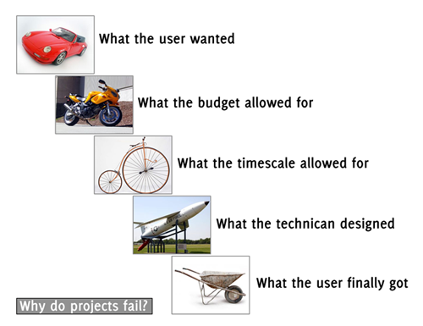
Why Projects Fail

Slide 14
Why Projects Fail ?
Poor project specification
Unrealistic timescales
  Timescales that are too long
Inappropriate staff
Failure to manage user expectations
Failure to manage the change required

